Slide 1
Wireless Networks
Lecture 16
GSM: Global System for Mobile Communication

Slide 2
Outlines
Review of Last Lecture
GSM Introduction
GSM System Architecture
GSM Network Areas
Specifications
Subscriber Services
Mobility
Identifiers in GSM Network

Slide 3
GSM Introduction
Analog systems:
inability to handle the growing capacity needs in a cost-efficient manner
Various systems have been developed without the benefit of standardized specifications.
Digital Systems:
Ease of signaling, lower levels of interference, integration of transmission and switching, and increased ability to meet capacity demands.
It addresses the specification issue particularly
GSM provides recommendations, not requirements.
The GSM specifications define the functions and interface requirements in detail but do not address the hardware to limit the designers as little as possible

Slide 5
The GSM network is divided into three major systems:
switching system (SS)
is responsible for performing call processing and subscriber-related functions.
base station system (BSS),
All radio-related functions are performed in the BSS, which consists of base station controllers (BSCs) and the base transceiver stations (BTSs).
operation and support system (OSS).
the functional entity from which the network operator monitors and controls the system.
To offer the customer cost-effective support for centralized, regional, and local operational and maintenance activities that are required for a GSM network.

Slide 7
Mobile Switching Centre MSC
the core switching entity in the network.
Is connected to the radio access network (RAN);
the RAN is formed by the BSCs and BTSs within the Public Land Mobile Network (PLMN).
all calls to and from the user are controlled by the MSC.
A GSM network has one or more MSCs, geographically distributed.
Base Station Controller (BSC)
provides all the control functions and physical links between the MSC and BTS.
It is a high-capacity switch that provides functions such as handover, cell configuration data, and control of radio frequency (RF) power levels in base transceiver stations.
A number of BSCs are served by an MSC.
Base Transceiver Station (BTS)
handles the radio interface to the mobile station.
The BTS is the radio equipment (transceivers and antennas) needed to service each cell in the network.
A group of BTSs are controlled by a BSC.

Slide 8
Home Location Register (HLR)
A database used for storage and management of subscriptions.
data about subscribers, including a subscriber's service profile, location information, and activity status.
When an individual buys a subscription, he or she is registered in the HLR of that operator.
Visitor Location Register (VLR)
A database that contains temporary information about subscribers that is needed by the MSC in order to service visiting subscribers.
The VLR is always integrated with the MSC.
For roaming user, VLR connected to that MSC will request data about the mobile station from the HLR through MSC.

Slide 9
Authentication Centre (AUC)
Provides authentication and encryption parameters that verify the user's identity and ensure the confidentiality of each call.
The AUC protects network operators from different types of fraud found in today's cellular world.
Equipment Identity Register (EIR)
A database that contains information about the identity of mobile equipment that prevents calls from stolen, unauthorized, or defective mobile stations.
The AUC and EIR are implemented as stand-alone nodes or as a combined AUC/EIR node.

Slide 10
Message Centre (MXE)
Provides integrated voice, fax, and data messaging.
Specifically, the MXE handles short message service, cell broadcast, voice mail, fax mail, email, and notification.
Gateway Mobile Services Switching Centre (GMSC)
a node used to interconnect two networks.
The gateway is often implemented in an MSC. The MSC is then referred to as the GMSC.
GSM inter-working unit (GIWU)
consists of both hardware and software that provides an interface to various networks for data communications.
Through the GIWU, users can alternate between speech and data during the same call.
The GIWU hardware equipment is physically located at the MSC/VLR.

Slide 11
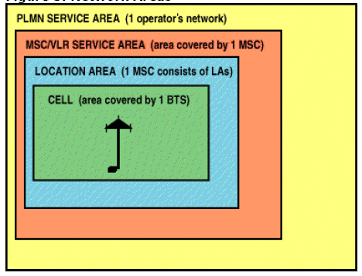
GSM Network Areas
Cell
Identified by cell global identity (CGI)
Location Area (LA)
Group of Cells, identified by LAI
MSC
Public Land Mobile Network
Service area of one operator

Slide 12
GSM Subscriber Services
There are two basic types of services offered through GSM:
telephony (also referred to as tele-services)
data (also referred to as bearer services).
Telephony services are mainly voice services that provide subscribers with the complete capability (including necessary terminal equipment) to communicate with other subscribers.
Data services provide the capacity necessary to transmit appropriate data signals between two access points creating an interface to the network.

Slide 13
In addition to normal telephony and emergency calling, the following subscriber services are supported by GSM:
Dual-tone multi-frequency (DTMF)
DTMF is a tone signalling scheme often used for various control purposes via the telephone network, such as remote control of an answering machine.
Facsimile group III
GSM supports CCITT Group 3 facsimile.
As standard fax machines are designed to be connected to a telephone using analog signals, a special fax converter connected to the exchange is used in the GSM system. This enables a GSM–connected fax to communicate with any analog fax in the network.

Slide 14
Short message services
A message consisting of a maximum of 160 alphanumeric characters can be sent to or from a mobile station.
If the subscriber's mobile unit is powered off or has left the coverage area, the message is stored and offered back to the subscriber when the mobile is powered on or has re-entered the coverage area of the network.
Cell broadcast
A variation of the short message service is the cell broadcast facility.
A message of a maximum of 93 characters can be broadcast to all mobile subscribers in a certain geographic area.
Typical applications include traffic congestion warnings and reports on accidents.

Slide 15
Voice mail
This service is actually an answering machine within the network, which is controlled by the subscriber.
Calls can be forwarded to the subscriber's voice-mail box and the subscriber checks for messages via a personal security code.
Fax mail
With this service, the subscriber can receive fax messages at any fax machine. The messages are stored in a service centre from which they can be retrieved by the subscriber via a personal security code to the desired fax number.

Slide 16
GSM Mobility
Roaming with GSM is made possible through the separation of switching capability and subscription data.
A GSM subscriber has her subscription data permanently registered in the HLR in his/her HPLMN.
The GSM operator is responsible for provisioning this data in the HLR. The MSC and GMSC in a PLMN, on the other hand, are not specific for one subscriber group.

Slide 17
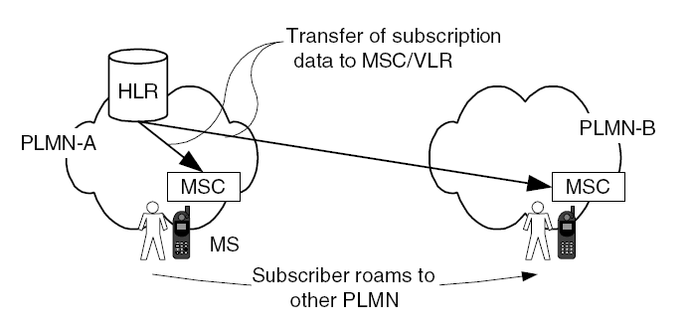

Slide 18
Mobile Station
Mobile Equipment (ME)
Subscriber Identification Module (SIM)
this is the chip embedded in the SIM card that identifies a subscriber of a GSM network;
When the SIM card is inserted in the ME, the subscriber may register with a GSM network.
The ME is now effectively personalized for this GSM subscriber;
The SIM card contains information such as IMSI, advice of charge parameters, operator-specific emergency number, etc.

Slide 19
Identifiers in the GSM Network
GSM uses several identifiers for
the routing of calls,
identifying subscribers (e.g. for charging),
locating the HLR, identifying equipment, etc.
International Mobile Subscriber Identity (IMSI)
It is embedded on the SIM card and is used to identify a subscriber.
The IMSI is also contained in the subscription data in the HLR.
roaming charging – a VPLMN uses the IMSI to send billing records to the HPLMN of a subscriber.

